Slide 1
Level 3: Caseworkers Adult Safeguarding Course

Slide 2
Aims and objectives
AIM
To enhance your knowledge and skills with regards to safeguarding, thinking critically about your role in protecting adults with care and support needs.
OBJECTIVES
To demonstrate an understanding of the implications of legislation, inter-agency policy and national guidance.
To demonstrate an ability to understand information sharing, confidentiality, and consent.
To demonstrate an understanding of the notion of proportionality in risk assessment.
To demonstrate and understanding of the role, remit and procedures of local safeguarding boards and panels.

Slide 3
Welcome, housekeeping & introductions

Slide 4
Training agreement (ground rules)
Each person has a valid contribution to make.
Give and receive constructive feedback.
Any multi-agency issues which arise may be discussed but should be done so professionally and with respect towards all course delegates.
Support the principle of confidentiality.
Use this session to network and share good practice.

Slide 5
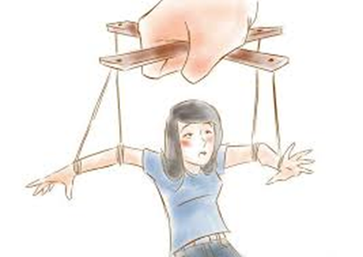
Vulnerabilities & strengths: defining care and support needs

Slide 6
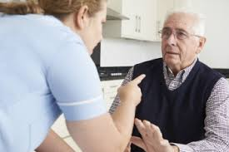
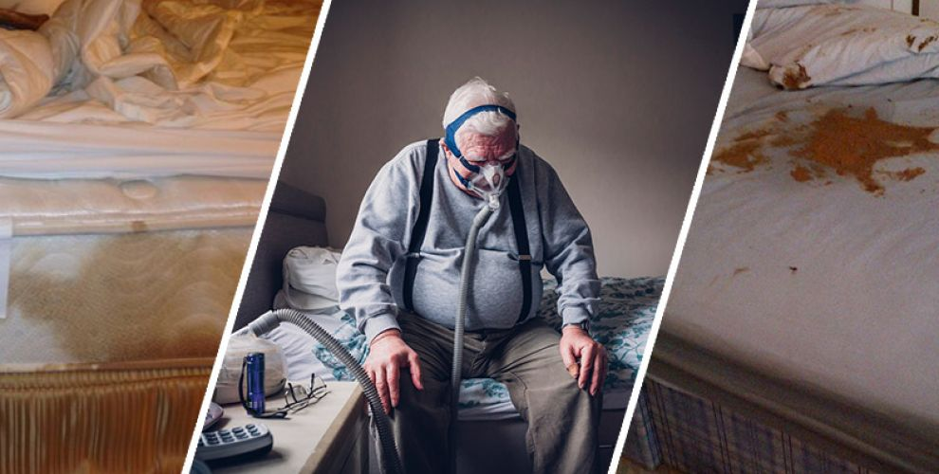
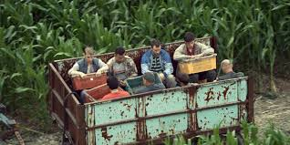
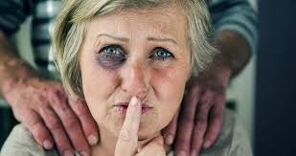
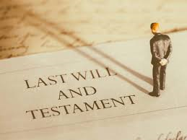
Local and national issues

Slide 7
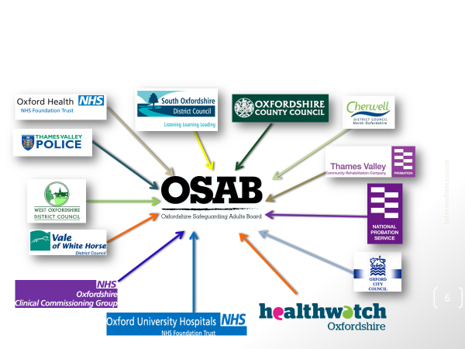
Legal Framework*
Human Rights Act 1988
Care Act 2014
Mental Capacity Act 2005
Mental Health Act 1983 (amended 2007)
Modern Slavery Act 2015
Anti-social Behaviour, Crime & Policing Act 2014
Serious Crime Act 2015
Equality Act 2010
Data Protection Act 2018
Inherent Jurisdiction of the High Court
*This list is not exhaustive

Slide 8
Confidentiality, information sharing & consent
Data Protection Act 1998 and the General Data Protection Regulations of 2018
Caldicott Guardian & Principles
Information Sharing Protocols
Seek Advice
Possible barriers to gaining consent and engagement

Slide 9
Decision Making in Practice Scenario

Slide 10
Independent Advocates
IMCA - Independent Mental Capacity Act Advocate
IMHA - Independent Mental Health Act Advocate
ICAA - Independent Care Act Advocate
POhWER – https://www.pohwer.net/oxfordshire

Slide 11
Break

Slide 12
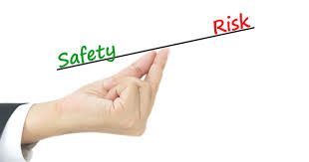
Assessing risk and protection planning
“Thinking about risk often involves an engagement with complex dilemmas and an acceptance that there may be no ideal solution” (Faulkner, 2012)

Slide 13
Assessing risk and protection planning
Proportionate response to risks posed
Differences of opinion (individual, carers, families, professionals)
MSP (Making Safeguarding Personal)
DASH (Domestic Abuse, Stalking and Harassment), own organisation’s, DST (Decision Support Tool), Health & Safety Risk Assessment Tool
MARAC (Multi Agency Risk Assessment Conference/Domestic Abuse focus), MARAMP (Multi Agency Risk Assessment Management Programme/Children focus) MAPPA (Multi Agency Public Protection Arrangements/Offender focus)
Knowledge of resources and services

Slide 14
Jigsaw Puzzle
Five groups
Put yourself in the role of the person highlighted at the top of the scenario.
10 minutes to discuss/consider

Slide 15
How to refer a concern
Workers/professionals:
Refer to Threshold of Needs Matrix
Call the Consultation Line, Safeguarding Adults Service (Oxfordshire County Council) on 01865 328232
Refer online via the OSAB website
Public:
Call the Social & Healthcare Team (Oxfordshire County Council) on 0345 050 76 66 (Monday to Friday only)
Refer online via the OSAB website.

Slide 16
The Adult Safeguarding Process
Initial fact finding.
Is the adult experiencing, or is at risk of, abuse or neglect?
If no, other non-safeguarding actions may occur.
Multi-agency policy https://www.osab.co.uk/wp-content/uploads/Procedure-for-adults-who-dont-engage-v2.pdf
If yes, formal Section 42 enquiry.
Safeguarding is not a substitute for the criminal justice system.

Slide 17
Section 42 enquiries
Establish facts
Ascertain adult’s views and wishes
Assess the need of the adult
Protect from abuse and neglect
What follow up actions?
Resolution and/or recovery
Enquiry concludes; risk remains, risk reduced, risk removed

Slide 18
A Response That Surprised You…
Insufficient response.
Respectfully challenge.
Own values and judgements.
Managerial escalation.
Whistleblowing, complaints etc.

Slide 19
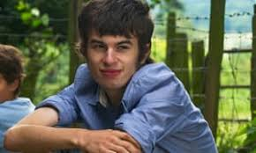
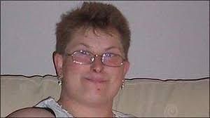
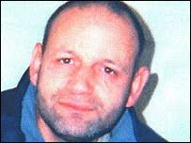
Learning from Reviews
Safeguarding Adult Reviews (SARs) - statutory responsibility
Other Review Processes
Local & National Learning – Hampshire County Council http://www.hampshiresab.org.uk/learning-from-experience-database/

Slide 20
Looking after yourself in Safeguarding
Nature of safeguarding work and impact
Opportunities to debrief
Peer Support
Supervision
Reflective and timely supervision
CPD (Continuing Professional Development) activities

Slide 21
Summary
Making Safeguarding Personal (MSP)
Balance risks, rights and ethics
Legal literacy
Partnership working
Ensure you are supported in your role

